Slide 1

Dialysis Analytics

Slide 2


Team Members-
GROUP – 1
Ms. Ananya Aswal
Mrs. Deepaveni Seggari
Ms. Punam Kurkure
Mr. Sumeet Rodge
Mr. Sumit Pramod More
Mr. Rohan Malhotra
Mr. Mandar L. Navalur

Slide 3









Dataset-
Domain- Healthcare
Project Name- Dialysis Analytics
Data Type- Csv Files
File Size- 10.9Mb
Files- Dialysis 1 & 2
Project Workflow-
Combined two different datasets in Excel using Power Query (Dialysis 1 & Dialysis 2)
Cleaning the files, replacing Duplicates & Null values.
Used Pivot tables & Charts to calculate the required KPI’s in Excel.
Executed the MySQL queries to get the output.
Created Interactive Dashboards in PowerBI by applying DAX & Tableau using Calculated field.
Provided insights for each KPI’s.

Slide 4

KPI’S
KPI 1- No. of Patients across various summaries
KPI 2- Profit Vs. Non-Profit Stats
KPI 3- Chain Organization w.r.t TPS as No Score
KPI 4 – Dialysis Station Stats
KPI 5 - # Category Text – As Expected
KPI 6 – Average payment reduction rate

Slide 5
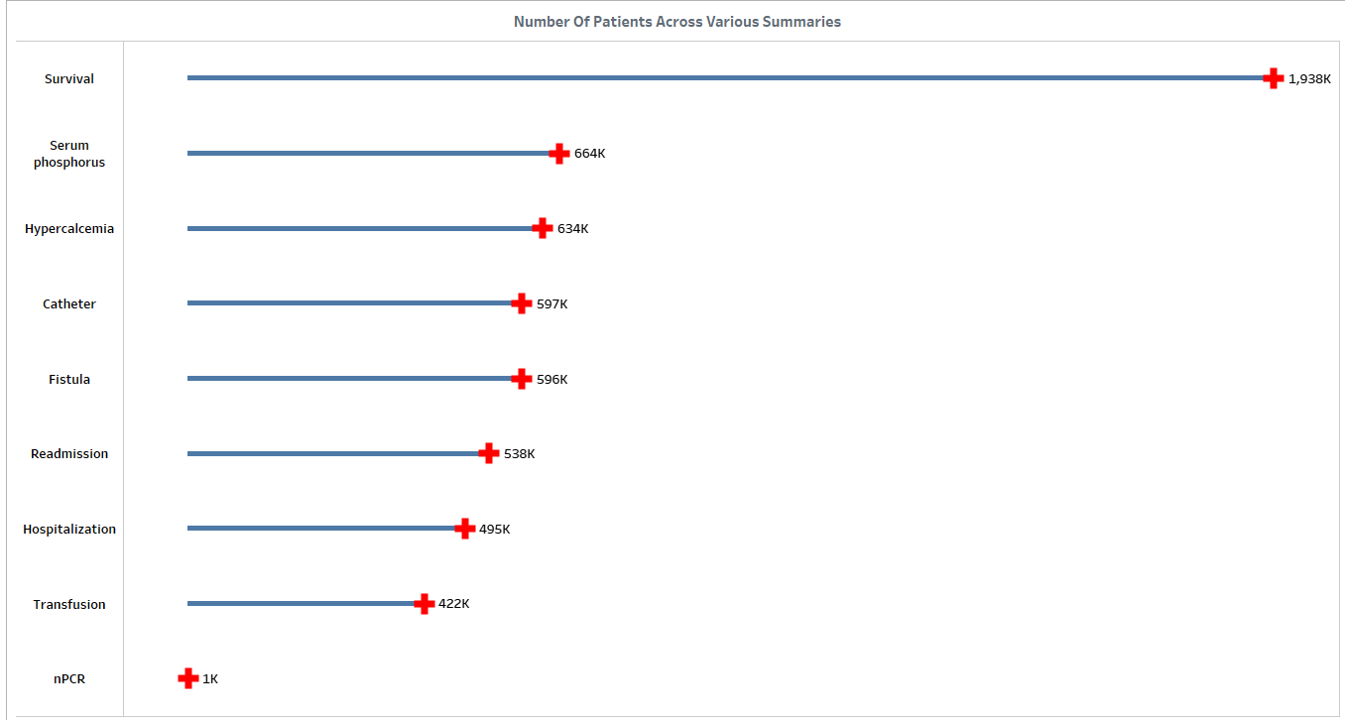
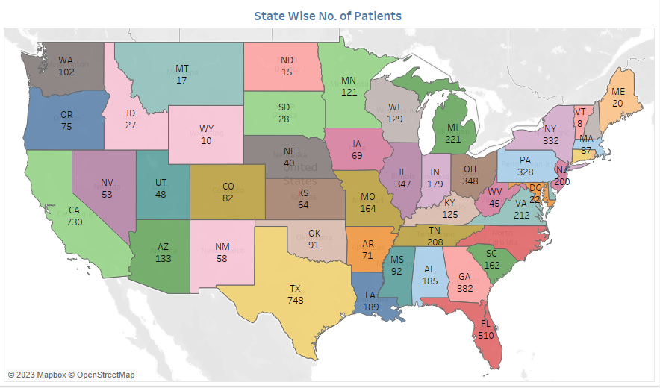
KPI 1- No. of Patients across various summaries
The nPCR summary has the lowest number of patients among all the summary types.
It means that the nPCR summary relates to a specific medical condition, treatment, or event that affects a smaller subset of patients.
The survival summary has the highest number of patients among all the summary types.
This could suggest that the survival summary type is relevant to a broad range of patients, or it’s a standard summary type used for tracking patient survival outcomes.

Slide 6
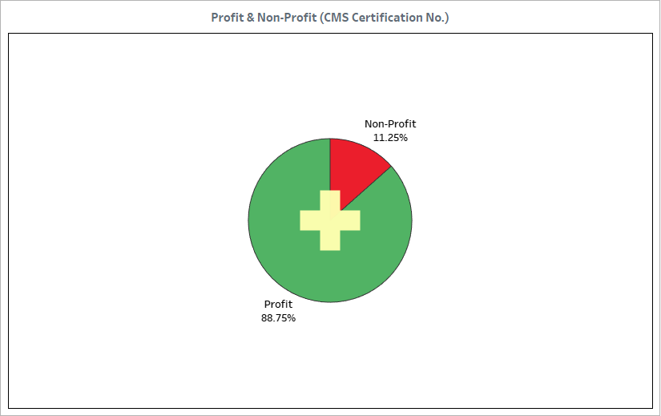
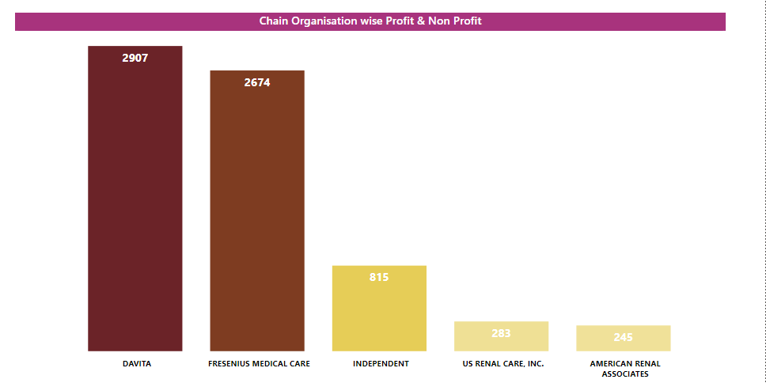
KPI 2- Profit Vs. Non-Profit Stats
Profit organizations have a significantly higher percentage (88%) compared to non-profit organizations (12%)
Profit Focus : The fact that 88% of the entities are classified as profit organizations indicates that a substantial majority of the organizations prioritize generating profits as a primary goal.
Non-profit organizations, constituting 12% of the total, are likely focused on achieving specific social, environmental, or charitable objectives rather than financial gains.
Business Environment : The distribution highlights the composition of the economic landscape, indicating a market where profit-driven activities are more prevalent.

Slide 7
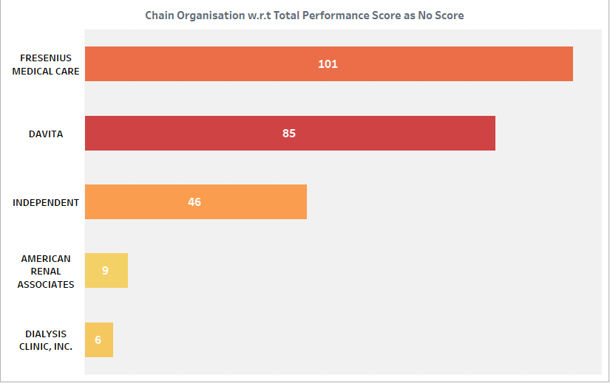
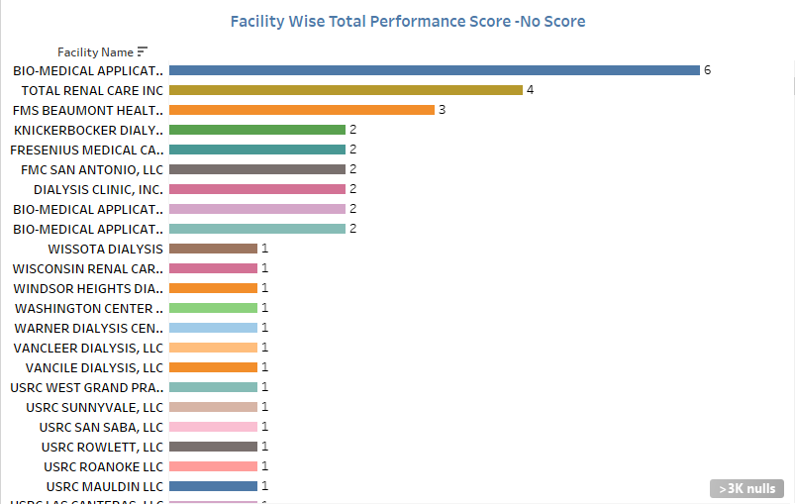
KPI 3- Chain Organization w.r.t Total Performance Score As No Score
Fresenius Medical Care has the highest count of 101 instances with "No Score" and US Renal Care, Inc. has the lowest count of 16 instances with "No Score,".
You can further analyze this data to gain insights into the performance of these chain organizations. By Comparing their sizes, geographic locations, types of services, and any other relevant factors.
This might include financial data, patient satisfaction scores, growth rates, and other relevant KPIs.
Further research into the root causes of missing scores could provide deeper insights. Investigating why specific chain organizations struggle with missing scores might reveal systemic challenges that need to be addressed.

Slide 8
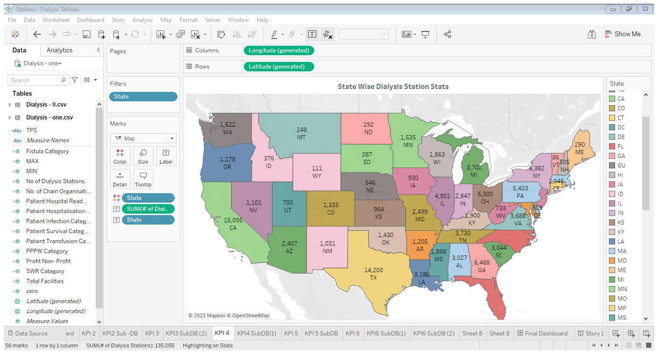
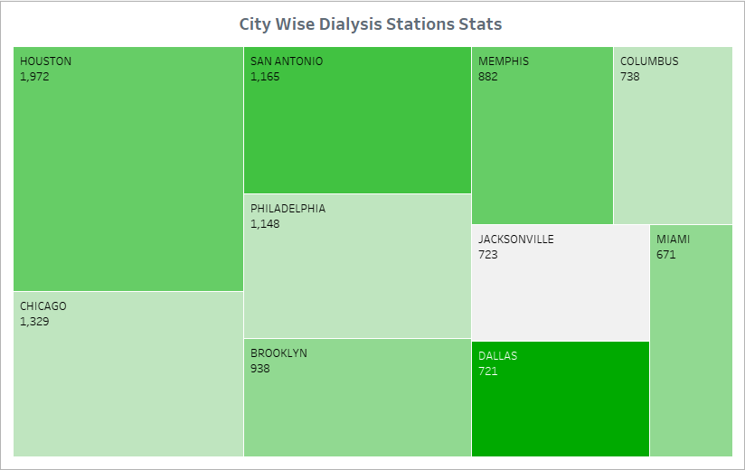
KPI 4 – Dialysis Station Stats
This data offers insights into the distribution of dialysis facilities across states.
The significant difference between the highest (CA) California and lowest (MI) Michigan numbers of dialysis stations indicates geographical disparities in the availability of dialysis services across states.
The higher number of dialysis stations in CA reflects the larger population and healthcare demand in the state.

Slide 9
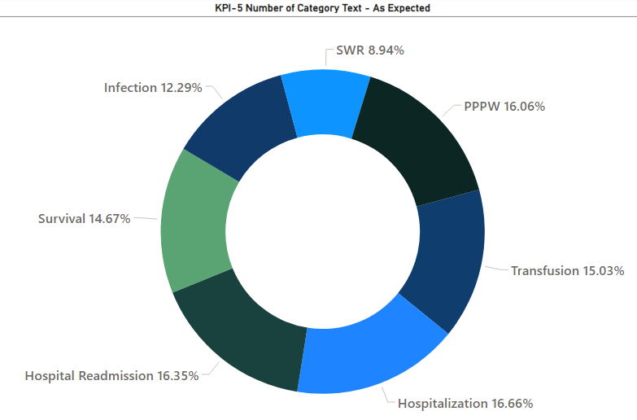
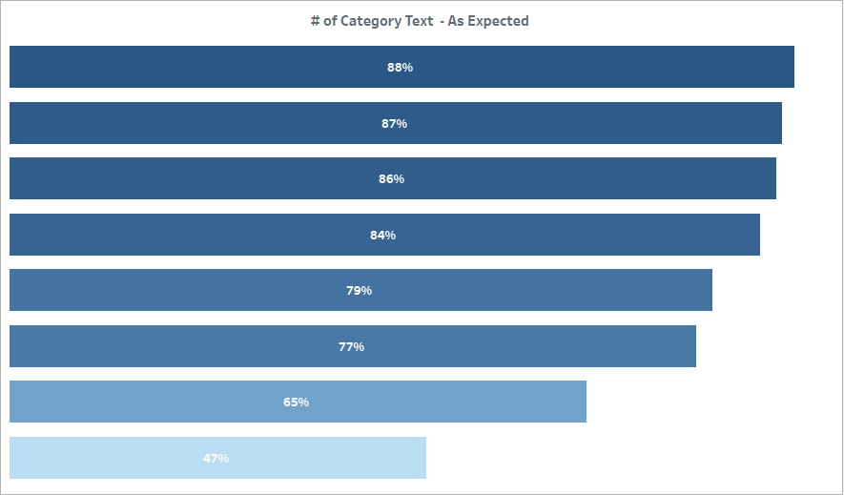
KPI 5 - # Category Text – As Expected
The variation in percentages across different category texts indicates diversity in the distribution of data among these categories.
A lower percentage for the "SWR" category indicates that data collection or reporting for this category is less frequent compared to others.
Categories with higher percentages, such as "Hospitalization," suggest that these areas are significant and likely to be more thoroughly recorded due to their critical importance.

Slide 10
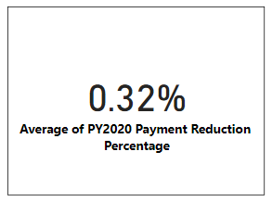
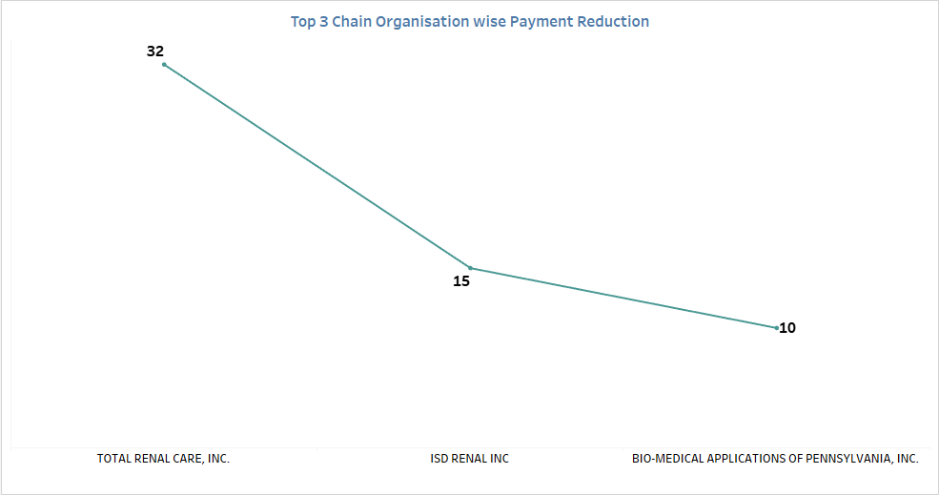
KPI 6 – Average Payment Reduction Rate
The average payment reduction rate is 0.32 percentage. This indicates that, on an average payments have been reduced by 0.32%.
Compare the organization's reduction rate to industry standards. If the reduction rate aligns with the industry norms, then its considered acceptable.
Evaluate the organization's financial stability. A minor reduction in payments might be manageable for financially sound organizations but more challenging for financially strained ones.

Slide 11
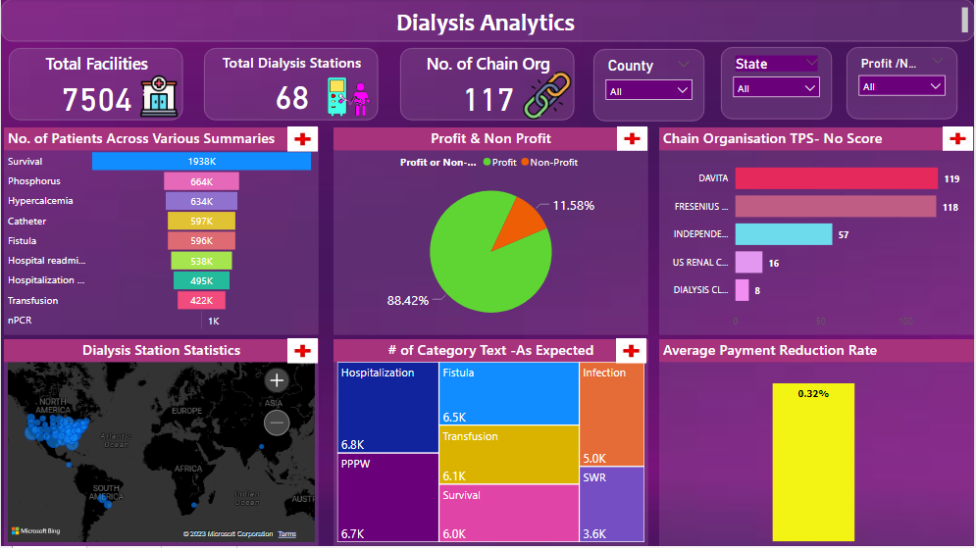
Power BI Dashboard

Slide 12
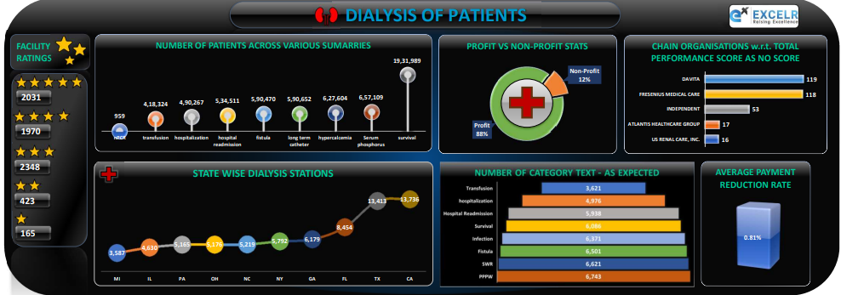
Excel Dashboard

Slide 13
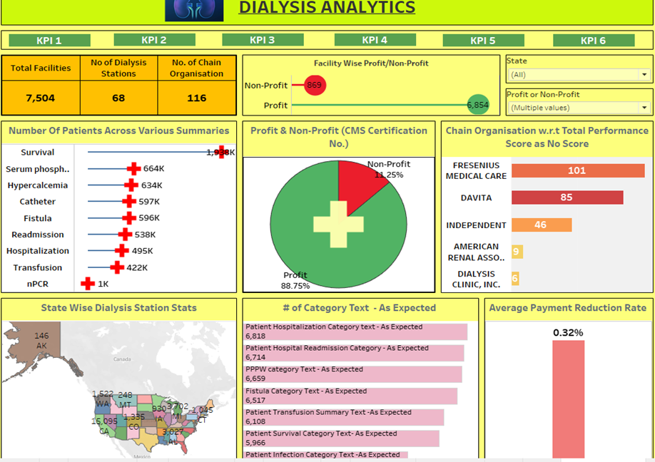
Tableau Dashboard

Slide 14

CONCLUSION
A comprehensive approach to healthcare management requires understanding patient distribution, financial stability, performance assessment, equity in service availability, and financial resilience.
Data accuracy, transparency, and effective resource allocation are critical for equitable and effective healthcare delivery. Collaboration between profit and non-profit organizations can create a holistic healthcare ecosystem that addresses diverse patient needs.
Identifying and addressing healthcare disparities ensure that all patients receive appropriate care regardless of geographic location or financial status.
Incorporating these conclusions into strategic planning, decision-making, and policy formulation will contribute to improved patient outcomes, resource optimization, and sustainable healthcare services.

Slide 15

THANK YOU

